Slide 1
The clinical learning environment
UB REds

Slide 2
Acknowledgements
No financial disclosures
Presentation adapted from Dr. Amy Westcott, Woodward Center for Excellence in Health Sciences Education, Penn State College of Medicine
Presentation content includes key themes discussed during small group session on the Learning Climate led by Kelley Skeff, MD, PhD, MACP, Stanford Faculty Development Center for Medical Teachers, Sept 2017

Slide 3
Objectives
Recognize strategies to promote a positive learning environment
Discuss medical school educational program objectives
Commit to reviewing and collaborating learning goals with your learners

Slide 4
Program Format
Learning Environment Scenario
TED Talk by Matt Goldman – “The Search for Aha Moments”
Key components of the learning environment

Slide 5
One type of learning environment…
Notes:
Scrubs - Dr Cox and JD - Flesh Eating Bacteria scene
Available on youtube
Play until 1:21

Slide 6
What elements of this scenario make it a safe or unsafe learning climate?
Discuss with your neighbor.
Share some examples as a group.
Notes:
The purpose of the video is to get audience engaged and warm up. Essentially only highlights examples of an unsafe learning climate (which are obvious). It will hopefully get them talking….
Think-pair-share
Discussion points:
Specific challenges to learning in the clinical environment
Impact on the observers watching the interaction – hidden curriculum (unprofessionalism)
Safe elements – attending supervises resident, they see the patient together, they discuss the case, resident speaks up when he does not agree
Unsafe elements – attending is unprofessional, does not support resident’s clinical impression, etc.

Slide 7
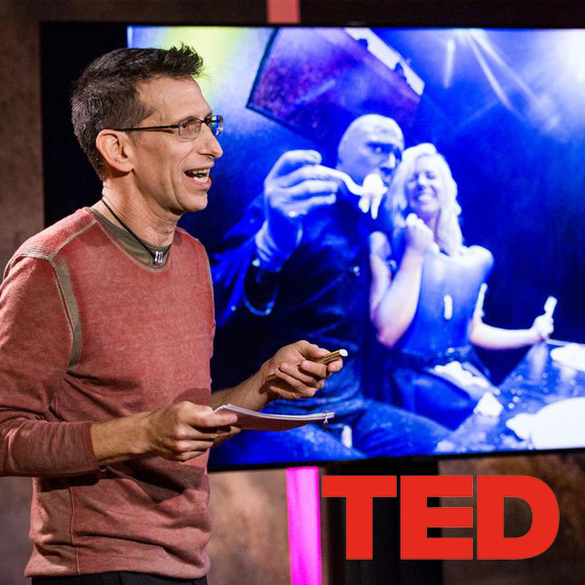
“The Search for Aha Moments”
Matt Goldman, co-founder of Blue Man Group and NYC based Blue School
Notes:
Matt Goldman discusses the importance of crafting a learning environment to inspire “aha moments”.
In this session we will discuss our training environment and how it supports us or hinders us from creating our own “aha moments”.
Reflective prompt:
Take a moment to envision your learning environment(s). In his TED talk, Matt Goldman identifies several factors that influence the quality of the learning experience. Choose and reflect on one characteristic. Why does this resonate with you and how you could address it in your own learning environment?

Slide 8
The Learning Environment – Optimum Conditions
Clear intent, purpose, & passion
Personal integrity
Direct communication & clear expectations
Grit & perseverance
Establish collaborative teams
Embrace multiple perspectives
Take risks & celebrate mistakes
Speak in one voice
Notes:
In his TED talk, Matt Goldman describes these criteria as part of the optimum conditions for innovative and creative environments
What are the optimum conditions for our learning environment? – Leads into activity on next slide

Slide 9
Think, Pair Share: Discuss 3 ways to promote a positive/safe learning environment
Notes:
Concepts to consider:
Stimulation (teaching behavior - enthusiasm, interest)
Learner involvement (teaching behavior – eye contact, listening, encourage participation, avoid one-way conversation)
Respect and comfort (teaching behavior – know learners’ names, invite learner opinion and respect divergent opinions, avoid ridicule/intimidate/interruption, acknowledge problems faced by learners)
Admission of limitations (teaching behavior – admit own errors/limitations, invite learners to do the same, acknowledge limitations in medicine and medical education, avoid being dogmatic)

Slide 10
Promoting A Safe and Positive Learning Environment
Do | Don’t
Use learners’ names | Call “medical student”
Ask about their interests | Assume that they are not interested just because shy
Discuss expectations | Assume students know process, how you want them to present, etc.
Narrow the learning goal | Pick something too broad or unattainable
Provide specific feedback | Tell the student to “read more”
Note: neque digni and in aliquet nisl et a umis varius.
Notes:
Review these points after discussing points identified in prior activity

Slide 11
Medical Education Curriculum
Competencies
Goals
Objectives
Feedback/Evaluation
Notes:
Summary/transition SLIDE – Transition to discussing the importance of knowing and setting goals and objectives as a foundation for a successful learning environment
Competency - the ability to do something successfully or efficiently. Graduate medical students competent to enter intern year.
Goal – the object of a curriculum or program’s effort; an aim or desired result. Think big picture. Match all the medical students.
Objective - statements that define the expected goal of a curriculum, course, lesson or activity in terms of demonstrable skills or knowledge that will be acquired by a student as a result of instruction. Also known as : Instructional objectives, learning outcomes, learning goals.
Feedback – Does the learner know what the teacher thinks about them?
Evaluation – Does the teacher know where the learner is?

Slide 12
Best Practice: Consider Everyone’s Needs
Student’s Learning Goals and Expectations
Student
Clerkship
Goals & Objectives
Teacher
Clerkship Goals and Expectations
Teacher’s Goals and Expectations
Adapted from Dr. Eileen Moser
Notes:
Role of the teacher is to consider and address everyone’s goals and expectations
How does the teacher make the content meaningful? (help the learner understand and retain it)
Is the teacher taking advantage of the learner’s motivation?

Slide 13
Learner Needs Assessment
Promotes student engagement and partnership
Provides the teacher with insight about student’s level of knowledge – tailor teaching based on student need
Improves the chances of achieving a “teachable moment”
Adapted from Dr. Eileen Moser

Slide 14
Jacobs School Educational Program Objectives
MEPOs (Medical Education Program Objectives)
Jacobs School of Medicine Learning Environment Policy
Jacobs School of Medicine and Biomedical Sciences Learning Environment Policy
Notes:
Medical Education Program Objectives –overarching goals for medical education curriculum, years 1-4. Currently under development.
Learning Environment Policy – outlines:
Standard of conduct
Student mistreatment
Guiding principles (duty, integrity, respect)

Slide 15
Summary
Promote a positive learning environment
Tailor your teaching to learner needs
Incorporate student, clerkship, and your own goals and objectives into your teaching
“We need to cultivate safe and conducive conditions for new and innovative ideas to evolve and thrive“
Matt Goldman

